Slide 1


A SURVEY ON LARGE LANGUAGE MODELS FOR RECOMMENDATION
Madison E. Chester | Dafni Tziakouri
Recommenders Presentation 2024

Slide 2
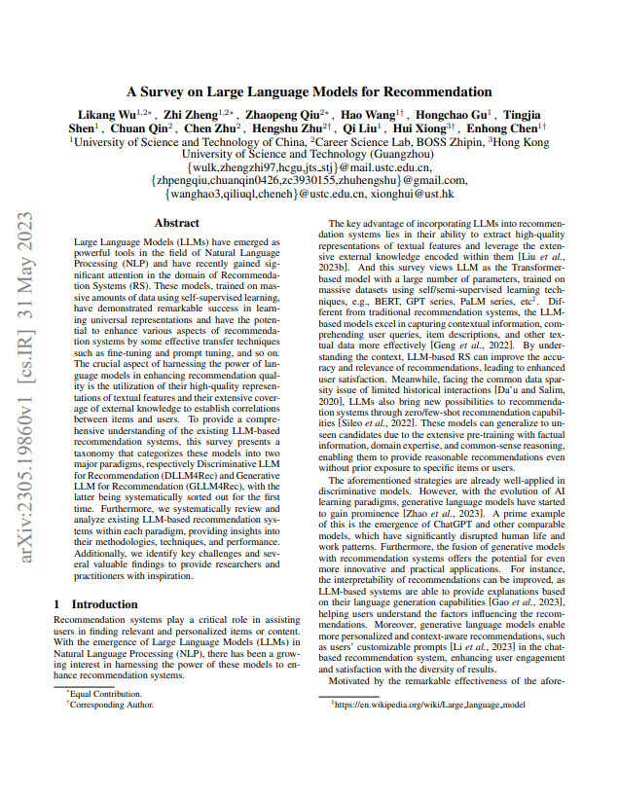
Content
01
LLMs & Advantages
02
Discriminative LLMs for RecSys
03
Generative LLMs for RecSys
04
Findings
05
Challenges
https://github.com/hongleizhang/RSPapers/blob/master/16LLM_for_RS/%5B23.05%5D%20A%20Survey%20on%20Large%20Language%20Models%20for%20Recommendation.pdf

Slide 3


LLMs & Advantages
Textual Information
Performance
User Engagement
Comprehending user queries
Improved accuracy
Satisfaction of results
Comprehending item descriptions
Improved relevance
Diversity of results

Slide 4

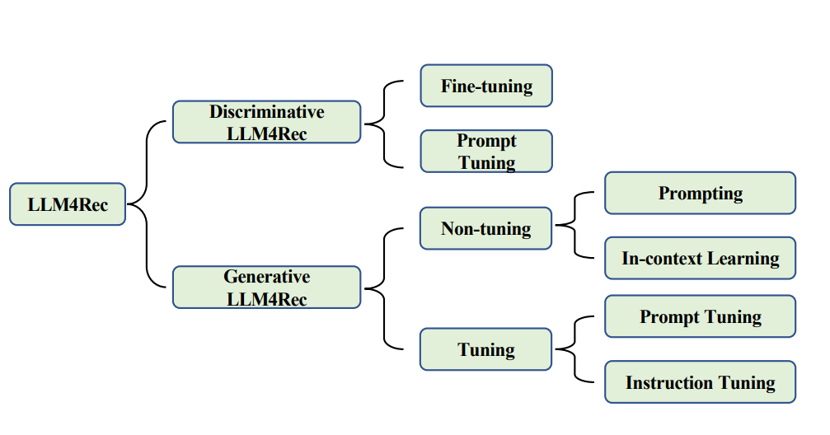
Overview

Slide 5
DISCRIMINATIVE LLMS

Slide 6
Fine-Tuning
Model: BERT series initialized with learned parameters
Fine-tuning done with domain-specific dataset (user-item interactions, user profiles, textual descriptions of items)
Parameters are then updated
Particularly important for sequential or session-based recommendation system

Slide 7
Prompt-Tuning
Align the tuning object with pre-trained loss through hard/soft prompts and label word verbalizer
Model: BERT Masked Language Modelling (MLM) and Next Sentence Prediction (NSP)
Experiments revealed that BERT can prioritize relevant items in the ranking process without fine-tuning
Performance notably enhanced with the utilization of multi-prompt ensembling (better than single-prompt results on discrete and continuous templates

Slide 8
GENERATIVE LLMS

Slide 9
Non-Tuning : Prompting
Aimed at designing more suitable prompts
Role instructions enhance the domain adaption ability
LLMs can function as the controller of the entire recommendation system
Can control the database and retrieve relevant content to address the cold start problem
Use Cases:
GENRE - refine news titles according to abstract, extract profile keywords from user history, generate synthetic news
NIR - generate user preference keywords & extract representative movies from user interaction history
5 Most Common Tasks:
rating prediction, sequential recommendation, direct recommendation, explanation generation, review summarization
Prompt Construction Framework:
1) task description
2) behavior injector
3) format indicator

Slide 10
Non-Tuning : In-Context Learning
Improves the recommendation ability of LLMs on most tasks
Demonstration input label-pairs are used to predict the label for an unseen output without additional parameter updates
Remaining Questions:
Selection and Number Demonstration Examples

Slide 11
Tuning
parameters of LLMs are trained on a specific task, and the LLMs are fine tuned for multiple tasks
Prompt Tuning
Instruction Tuning
Input: user/item information and Output: User preference or ratings of items
Rating predictions require multi-class classification and regression
LLMs can learn how to recommend but language biases still exist for bottom recommendations
LLMs can align with human intent
Models can achieve zero-shot generalization to unseen personalized prompts and new items
Main tasks include respectively scoring, generation, and retrieval

Slide 12
FINDINGS & CHALLENGES

Slide 13
Model Bias
Position
Popularity
Fairness
The infromation is stored in textual sequential descriptions
LLMs prioritize the items in the top order
Random sampling-based bootstrapping
The ranking results of LLMs are influenced by the popularity levels of the candidates
Popular items tend to rank higher
Fairness issues related to sensitive attributes
Influenced by the training data and the demographics of the individuals
Assume users belong to a specific group (race or gender)

Slide 14
Recommendation Prompt Designing
User/Item Representation
Limited Context Length
LLMs are not using sufficient representation of data
Name to represent items. List of item names to represent users
Challenging to use ID-like features
Constrain the length of users’ behavioral sequences
Number of candidate items
Selecting representative items from user behavior sequences

Slide 15
Promising Ability
Zero/Few-shot Recommendation
Explainable
Few-shot learning does not change the parameters of LLMs
Reduce the cold-start problem with limited data
Guidance in selecting representative demonstration examples
LLMs have a remarkable ability for natural language generation
ChatGPT performs better than supervised traditional methods
Promising performance in explainable Rec from LLMs

Slide 16
Evaluation Issues
Generation Controlling
Evaluation
criteria
Datasets
LLMs may not follow the desired output format
Answers in different formats or refuses to answer
Crucial to find a solution in controlling the output of LLMs
LLMs have strong generative capabilities
Generate items that have never appeared in the historical data
Still not any possible solution
MovieLens, Amazon Books, etc.
Relatively small in scale, may not reflect the Rec capability of LLMs
Related information in the pre-training data
Introduce bias

Slide 17
THANK YOU FOR YOUR ATTENTION!

